Slide 1
水墨风格化 与 基于泊松融合的简单元素编辑
牛晨雨
2022/12/26

Slide 2
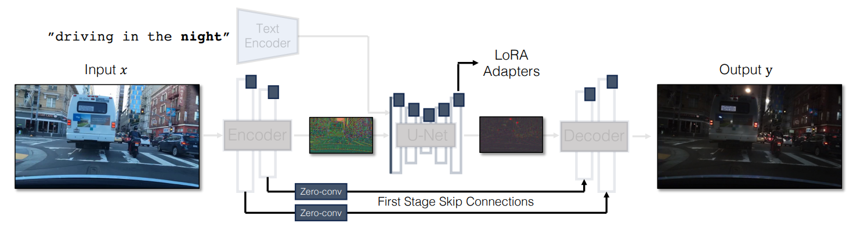
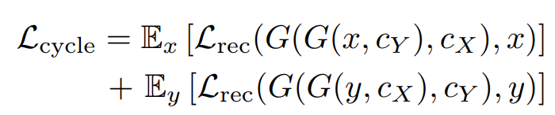
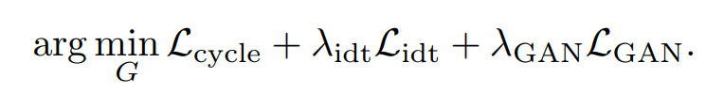
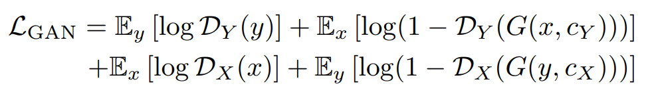
CycleGAN-Turbo
https://arxiv.org/pdf/2403.12036

Slide 3
CycleGAN-Turbo Training
Datasets
Real world landscape photos from https://www.kaggle.com/datasets/arnaud58/landscape-pictures
Traditional Chinese landscape paintings from https://github.com/alicex2020/Chinese-Landscape-Painting-Dataset
Image size: 256 * 256
Training time: 17.5h on one NVIDIA GeForce RTX 4090

Slide 4
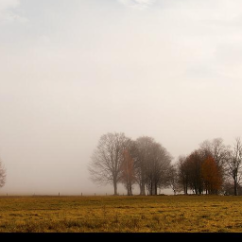
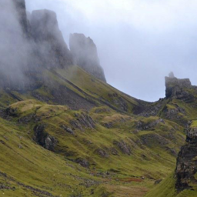
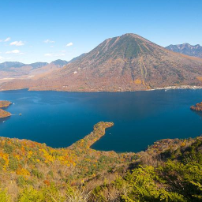
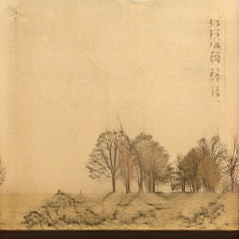
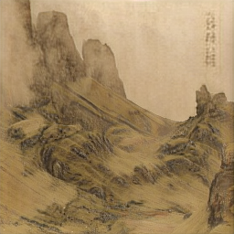
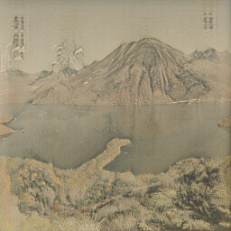
CycleGAN-Turbo Result

Slide 5
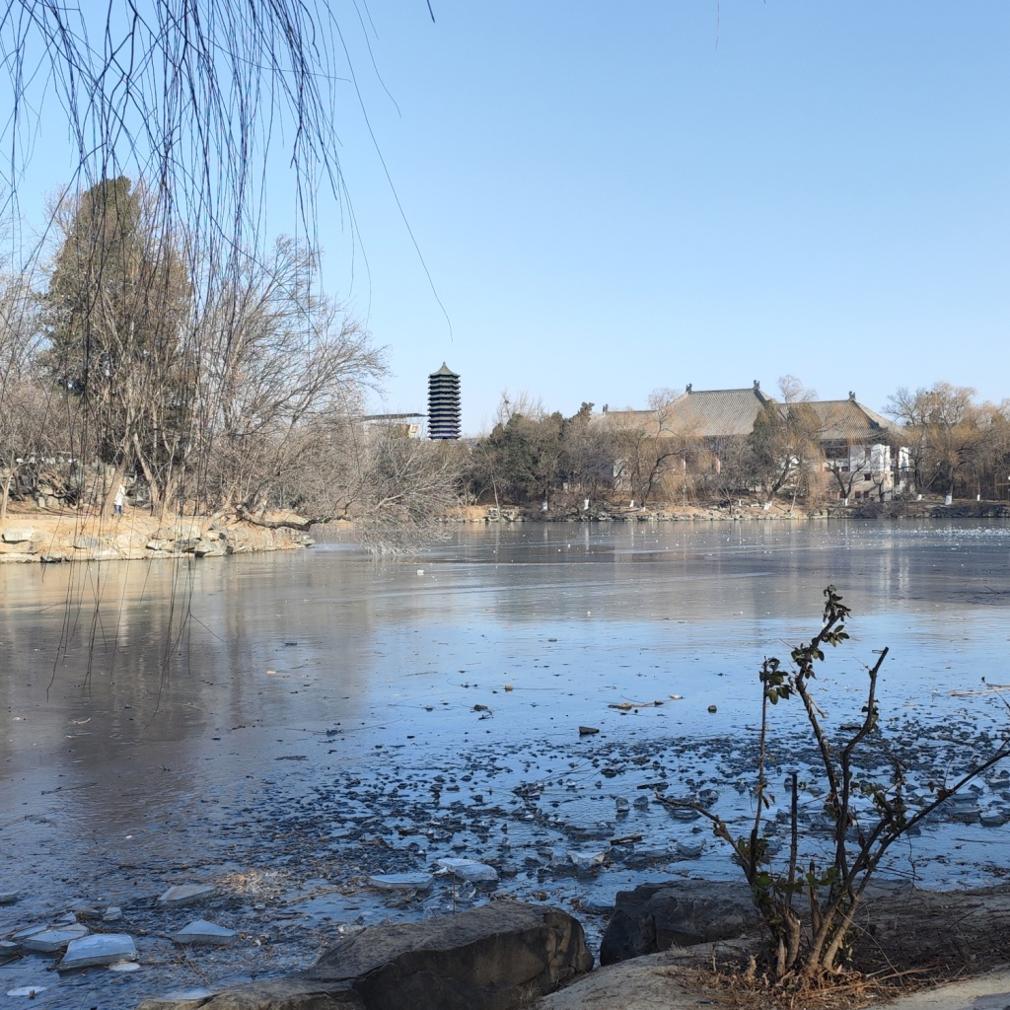
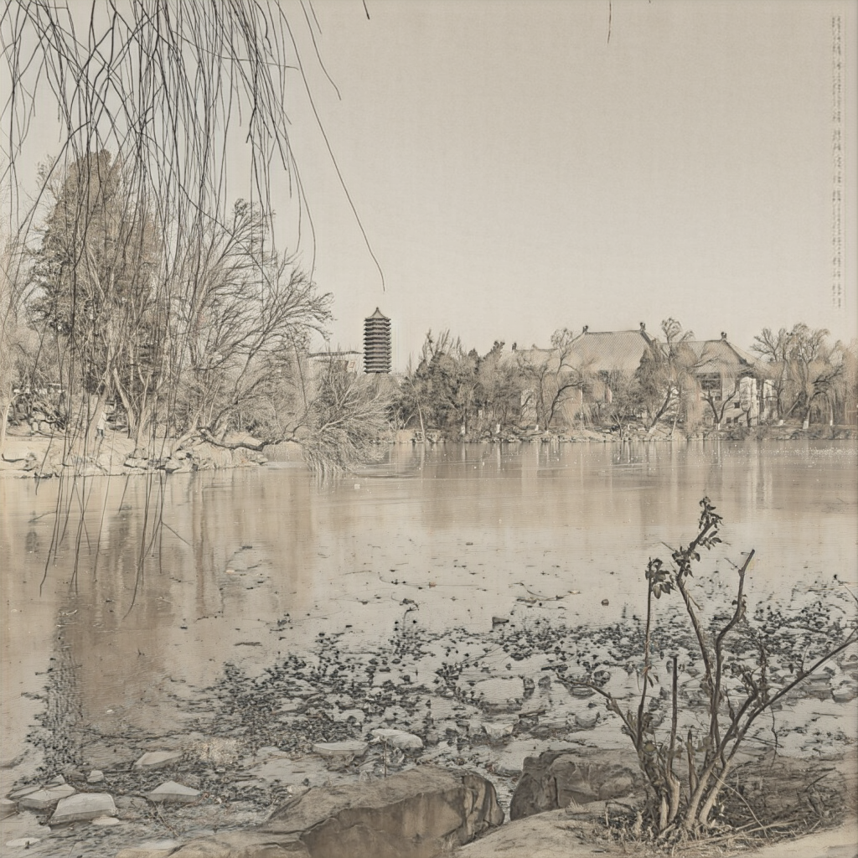
Apply on PKU

Slide 6

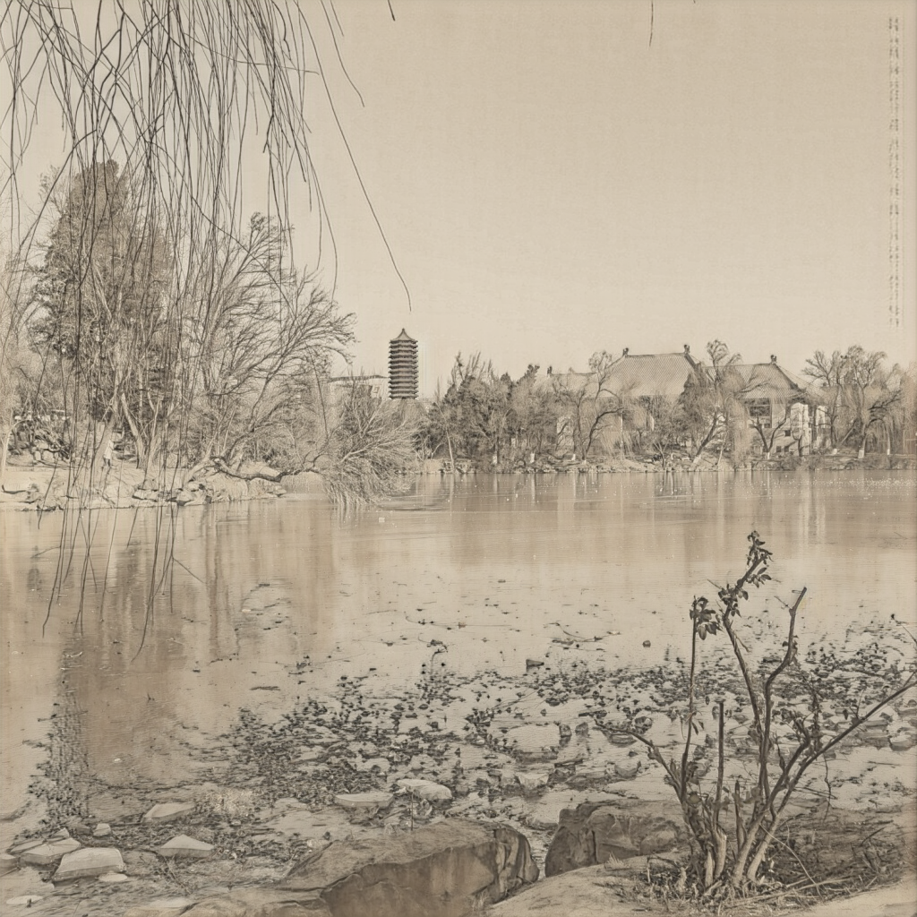
Apply on PKU

Slide 7

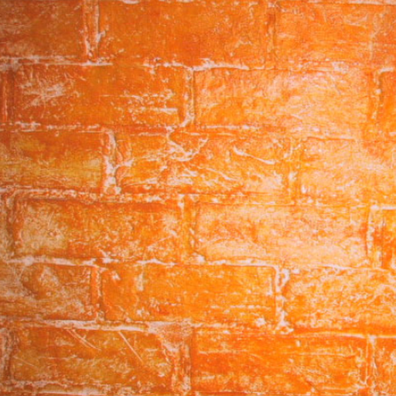


Poisson Image Editing
dst
Result (mixed gradient)
mask
src
https://dl.acm.org/doi/pdf/10.1145/1201775.882269

Slide 8
